Slide 1
NARA's Digitization Regulations – Frequently Asked Questions
December 14, 2023
Digital Government Institute Virtual Workshop:
Digitization Best Practices

Slide 2
Agenda
Introduction
Digitization webpage
Permanent vs temporary records
Digitization regulation vs FADGI
Quality Management Guide
Validation vs verification
Digitization Success Criteria White Paper
Agency responsibilities
Exceptions process
FAQ on Non-compliant Digitized Records
Notes:
ARIAN

Slide 3
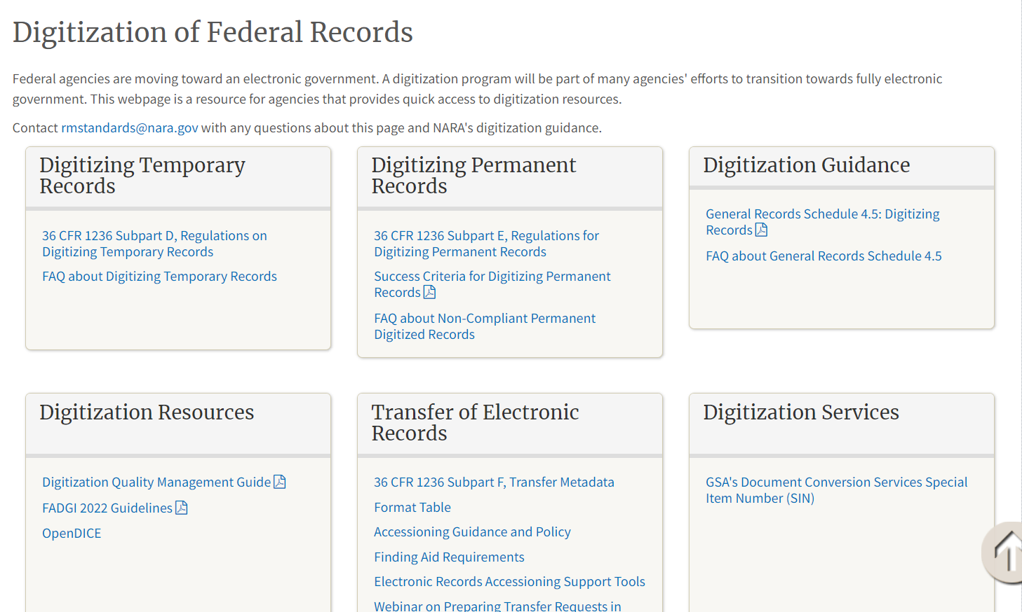
Digitization Webpage
https://www.archives.gov/records-mgmt/policy/digitization

Slide 4
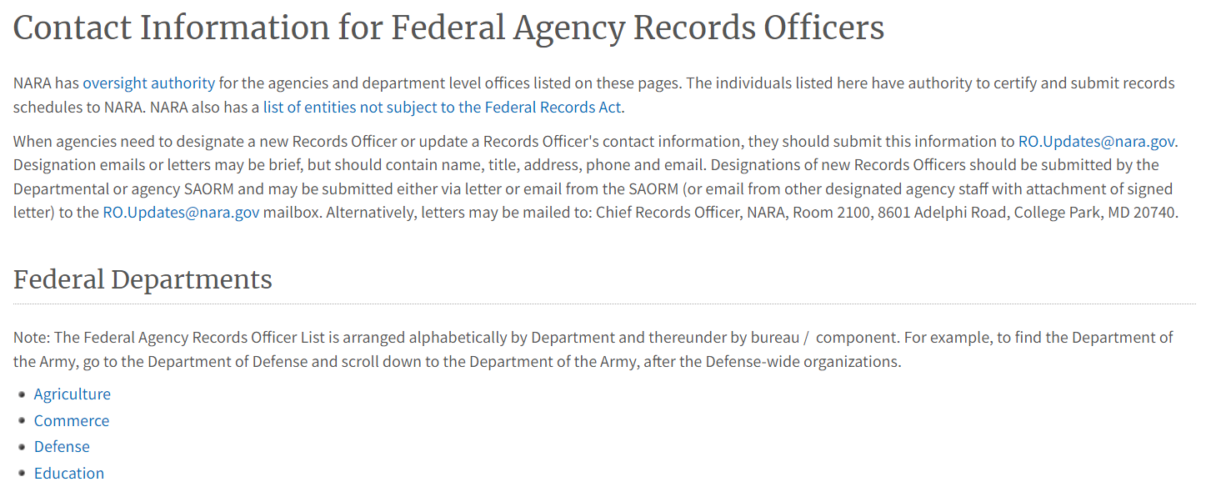
Agency Records Officer Contact Information
https://www.archives.gov/records-mgmt/agency

Slide 5
Digitization Standards for
Temporary Records
36 CFR Subpart D -- Digitizing Temporary Federal Records
1236.30 Requirements for digitizing temporary records
1236.32 Digitization standards
1236.34 Validating digitization
1236.36 Disposing of original source records

Slide 6
Digitization Standards for
Permanent Records
36 CFR Subpart E -- Digitizing Permanent Federal Records
1236.40 Scope of this subpart
1236.41 Definitions for this subpart
1236.42 Records management requirements
1236.44 Documenting digitization projects
1236.46 Quality management requirements
1236.48 File format requirements
1236.50 Digitization requirements for permanent paper and photographic prints
1236.52 Digitization requirements for permanent mixed-media files
1236.54 Metadata requirements
1236.56 Validating digitized records and disposition authorities

Slide 7
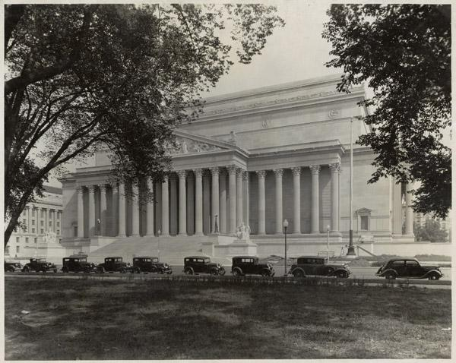
NARA Regulations vs FADGI
FADGI 3-star is NOT the requirement
Federal Agencies must comply to NARA Regulations found in 36 CFR 1236
FADGI has good best practices but is not the regulatory authority for compliance
The minimum requirement equates to FADGI Modern Textual records category
The technical specifications derive from ISO 19264
Notes:
As John said NARA’s regulation is more of a Relationship with FADGI. FADGI is a guidance document and not a standard, nor is it a regulation. The FADGI guidance consists of an implementation of the ISO 19264 aimpoints and tolerances as applied to over 14 different records material types divided into 4 different image quality. NARA has adopted the FADGI quality metrics and Digital image conformance evaluation method. However FADGI is a guidance document intended for an international audience and does not apply to the digitization of permanent federal records.
FADGI 3-star is NOT the requirement. Federal Agencies must comply to NARA Regulations found in 36 CFR 1236. However it is the technical basis for the regulations. The differences are not great but agencies must be careful when responding to vendor claims. The FADGI process is how we trust but verify. And FADGI 3* has become the marketing short hand. Meeting the standard is complex and the result of measuring multiple image quality parameters.
NARA developed A new FADGI category for modern textual records as the minimum. You may have to exceed 3 star for some records to capture all the information.
Similar to FADGI 3* for unbound textual general collections
Designed for modern office records that have white paper and black text.
The vast majority of records are temporary, less than 3% are permanent, and 80% of textual records are modern paper
Appropriate for mass digitization greyscale and auto feed scanners
the two darkest patches of target are not measured
Specifically there are file formats and file compression, metadata, and records management that are slightly different.
So basically it is the narrative elements of some of FADGI guidance that differ but the core image quality specifications are the same
We have taken the FADGI specifications as the standard for the reformatting of source records to create a digital surrogate
Please take the time to read the regulation and the fadgi guidelines. The previous fadgi guidelines contain some background information that might be a little out of date but valu

Slide 8
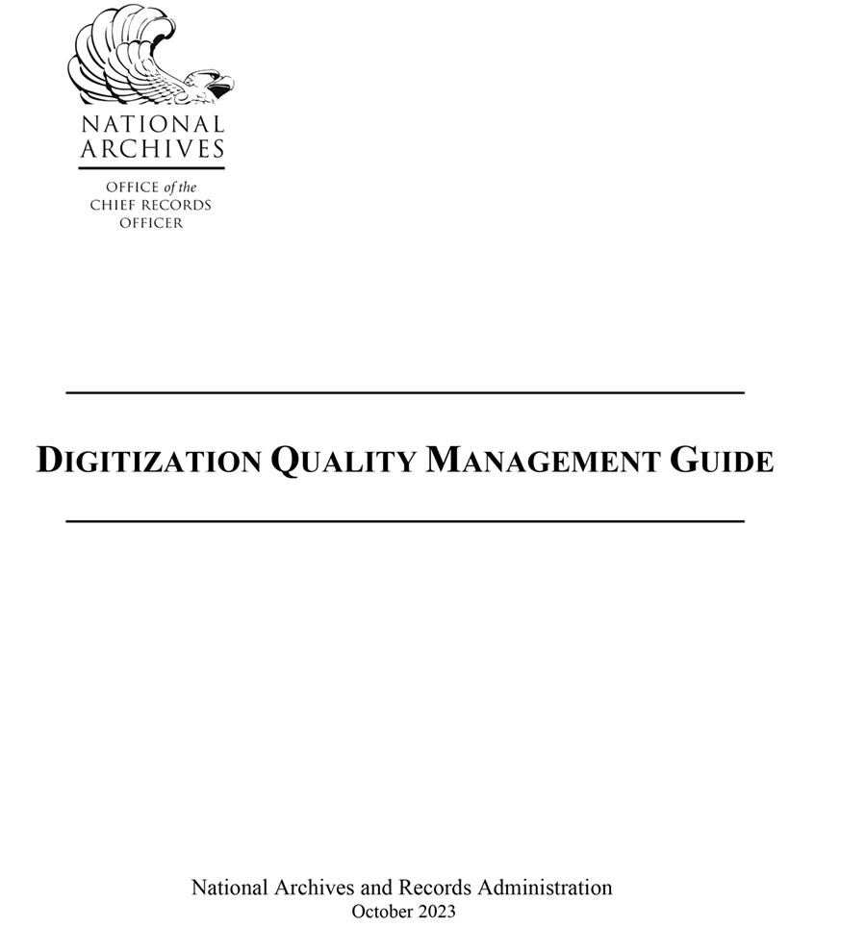
Quality Management
Quality management (QM) is the overall management function and underlying activities that determine quality
Quality assurance (QA) is a proactive quality management (QM) activity focused on preventing defects.
A QA program is heavily dependent on quality control (QC) data to search for patterns and trends.
Notes:
NARA’s Digitization Quality Management guide was written to help agencies learn about the various aspects of QM in digitization, including quality assurance and quality control, as well as the role of objective testing and automation in optimizing quality control and inspection processes.
This guide supports the National Archives and Records Administration's (NARA) regulations
concerning digitization standards for permanent and temporary records (36 CFR 1236 Subpart D)
The guide begins with the quote:
Inspection with the aim of finding the bad ones and throwing them out is too late, ineffective, and costly. Quality comes not from inspection but from improvement of the process.” W. Edwards Deming
If you are relying on inspection to establish quality you are in trouble.
The goal of quality management (QM) in a digitization project is to prevent defects before they happen. Prevention of defects is the most efficient, cost-effective, and productive activity in a digitization workflow. Digitization is an image manufacturing process that relies upon quality assurance (QA) to establish specifications and requirements, and a quality control (QC) process to test for and inspect defects. A well-run digitization operation will be proactive rather than rely upon QC inspection to achieve quality.
NARA’s digitization regulations could be considered a total quality management document that brings together records management practices, digital imaging quality standards, quality control, inspection, and validation steps. Each phase of a digitization project affects the other parts. For example, establishing intellectual and physical control contributes to creating metadata as well as identifying missing records. The quality control and inspection steps have been optimized to rely on automated processes where possible and limit human inspection to the phases that cannot be automated. By relying on objective testing and analysis for image quality, we eliminate wasteful subjective inspection of attributes. Finally, the validation phase is a high-level review to verify that all the requirements of a project have been met and the digital surrogates can serve the same legal and evidentiary purpose as the source records.

Slide 9
Verification vs Validation
Verification occurs throughout the digitization process where parameters are checked to ensure that the digital records comply with the the requirements in the regulation.
Validation is the records management process at the end of the process where agencies affirm that their digital records are complete, accurate, comply with the standards in the regulations, and can be used for the same business purposes as the source records.
Notes:
KEVIN
Validating Digitized Records and Instructions for Disposing of Records:
Ensure that digitized records meet all image quality, metadata, and records management requirements
A separate step from quality management
Ensure that the digitized records are complete and accurate, and can meet the same business needs as the originals
Agencies should consult with their General Council to ensure that their validation process is sufficient

Slide 10
Success Criteria White Paper
Assists agencies in digitizing permanent records and meeting federal records management requirements in laws, regulations, and NARA-issued policy.
If not properly managed, digitization can result in incomplete/insufficient digital record quality to serve all of the same business purposes as the originals.
Helps agencies to adhere to the requirements in 36 CFR 1236 subpart E, and other recordkeeping requirements to help mitigate many of the risks inherent in digitization.
Provides high-level success criteria for digitizing permanent records, which are organized around four key concepts: Policies, Access, Systems, and Disposition.

Slide 11
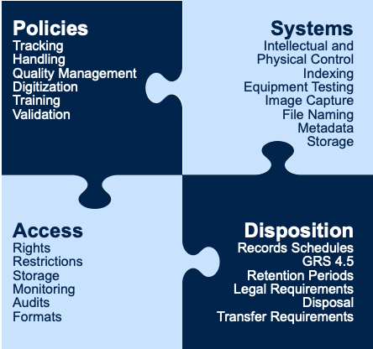
Categories

Slide 12
What Success Looks Like
Policies:
Roles and responsibilities
Procedures for handling source records
Digitizing source records
Quality management
Managing digital records
Validating digitization processes
Disposition

Slide 13
What Success Looks Like
Systems:
Agencies must have systems in place capable of digitizing, managing, accessing, preserving, and transferring permanent records in acceptable digital formats with required metadata.
Systems for managing source records
Systems for creating digitized records
Systems for managing digitized records

Slide 14
What Success Looks Like
Access
Records must remain usable and retrievable.
Access is dependent on agencies establishing and maintaining intellectual and physical control of records throughout their lifecycle to support an agency’s ability to carry out its business functions.
Your agency can provide access to meet internal agency needs and accommodate responses to requests for information.
Access for source records
Access for digitized records

Slide 15
What Success Looks Like
Disposition
Paper and analog source records
Digital records

Slide 16
Non-Compliant Digitized Records
Non-compliant digitized records do not meet the standards in the regulations
Options:
Submit a new records schedule
Re-digitize and validate the source records according to the standards
Transfer the born-digital records
Send the source records to NARA before June 30, 2024
Media-neutral records schedules
Frequently Asked Questions (FAQ) about Non-Compliant Permanent Digitized Records
Webinar on Non-Compliant Digitized Records FAQ-January 10, 2024
Notes:
ARIAN

Slide 17
Agency/NARA Responsibilities
Validation (§ 1236.56 Validating digitized records)
Agency verifies:
All records identified in the project's scope have been digitized;
All required metadata are accurate, complete, and correctly labeled;
All image technical attributes have been met;
All image files legible and all necessary physical characteristics captured;
Mixed-media files are digitized or associated appropriately; and
Project documentation has been created.
NARA does not:
Review/certify agency validation
Require transfer of digitization documentation

Slide 18
Exceptions
Section 2.1 of M-19-21 Transition to Electronic Records
Categories:
burdensome to the public
cost would exceed the benefit
analog records cannot be replaced for some other reason
Exceptions will be based on a combination of criteria as part of an overall business case
Exception requests
considered in the context of an agency’s overall RM program
analysis of agency records and business needs
one request to cover all the records series
NARA Bulletin 2020-01 Guidance on OMB/NARA Memorandum Transition to Electronic Records (M-19-21)

Slide 19
Questions?
Seventh and eighth grade class in Westley, CA school after lesson in geography. National Archives Identifier: 148741583.

